Slide 1

An Open-Source Collaborative
Framework for Digital Health

Slide 3
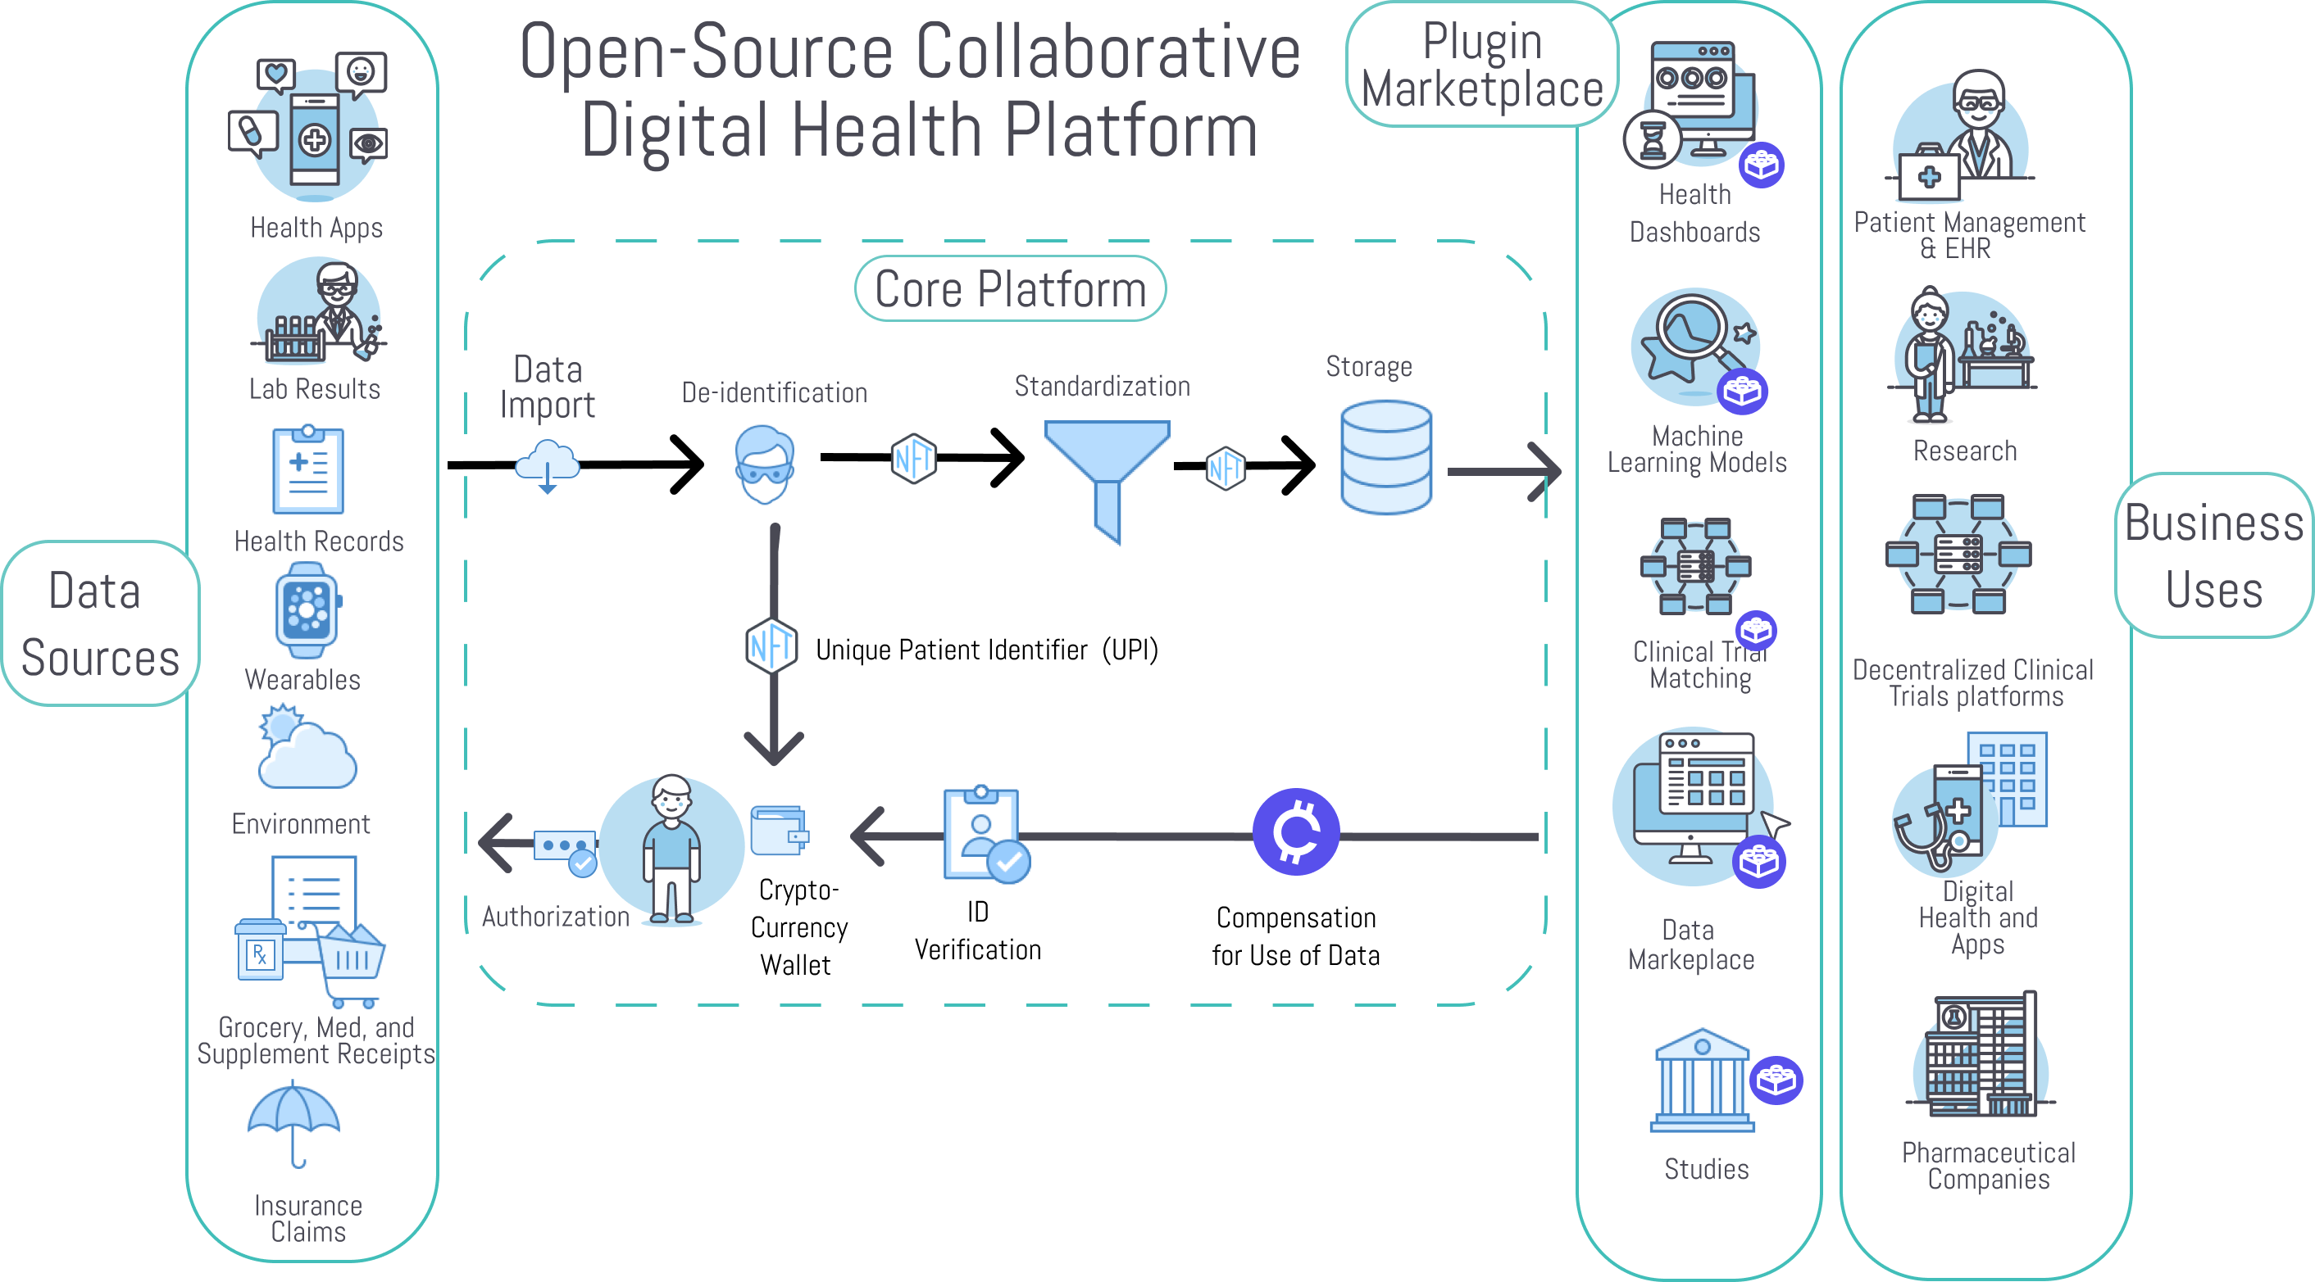

Slide 4
Why is this necessary?
Notes:
So there are already hundreds of thousands of apps and dozens of decentralized research and digital health platforms. So why do we need yet another one?

Slide 5
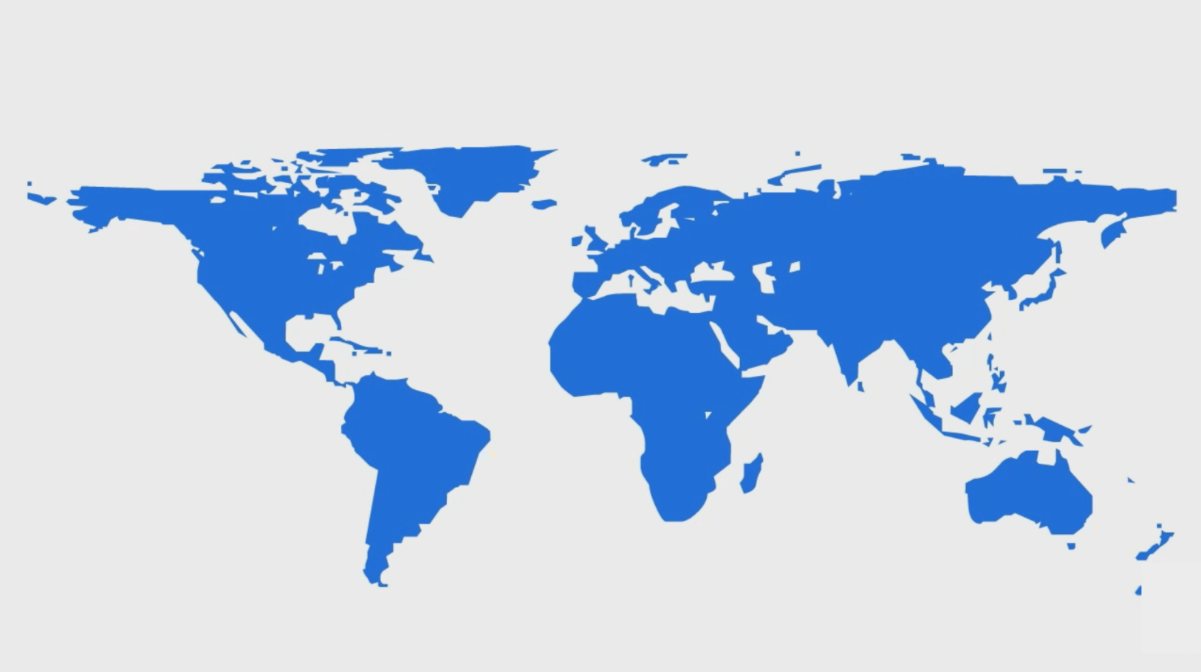
2 BILLION PEOPLE ARE SUFFERING FROM CHRONIC DISEASES
Arthritis
Type 1 Diabetes
Mental Illness
479 million sufferers
Bipolar Disorder
Autoimmune Diseases
448 million sufferers
Crohn’s Disease
Alzheimer’s Disease
Depression
Multiple Sclerosis
Fibromyalgia
Anxiety Disorder
Notes:
A half-billion are suffering [pause here] from autoimmune diseases like Crone's disease, psoriasis, and Fibromyalgia.
Since there’s also a great deal of mounting evidence that treatment-resistant depression mental and other mental illnesses are strongly related to immunodysregulation.
So what all these diseases have in common…

Slide 6
















The severity of most chronic diseases is influenced by hundreds of factors.
Diet
Social
Symptom Severity
Sleep
Exercise
Treatments
Environment
Notes:
...is that they can be exacerbated or improved by hundreds of factors in daily life like
Probably the most significant is the 3 pounds of thousands of unresearched chemicals that we consume every day through our diets.
And the since the thousands of chemicals in our food have been GRAS or “Generally recognized as safe” by the FDA, there’s no incentive to do research.
How much sleep did I get?
What medications did I take?
How much sugar did I consume?
How much gluten did I consume?
gluten intake,
Sugar,
diet,
sleep,
exercise,
social interaction,
and even the weather.
Unfortunately, the human mind is only capable of holding 7 numbers in working memory at a time.
Exclude recommended daily allowance
Brains don’t have the bandwidth or statistical processing power required to analyze the massive amount of longitudinal data, time delays, and durations of action that has to be taken into account if we are to determine the likely influence of each of these factors on the individual’s symptoms.
So we built QuantiModo to aggregate and analyze this data to determine which of these hundreds of factors have the strongest relationships the symptom or outcome of interest.

Slide 7
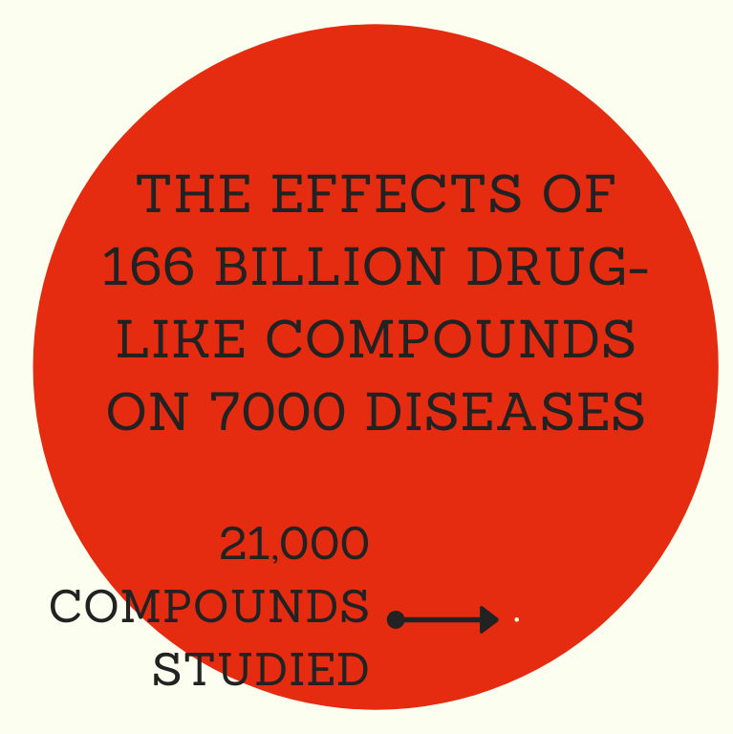

Slide 8
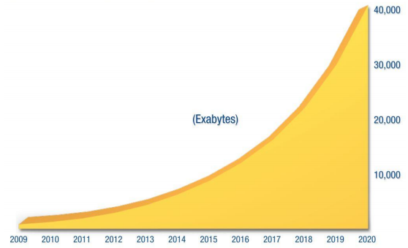
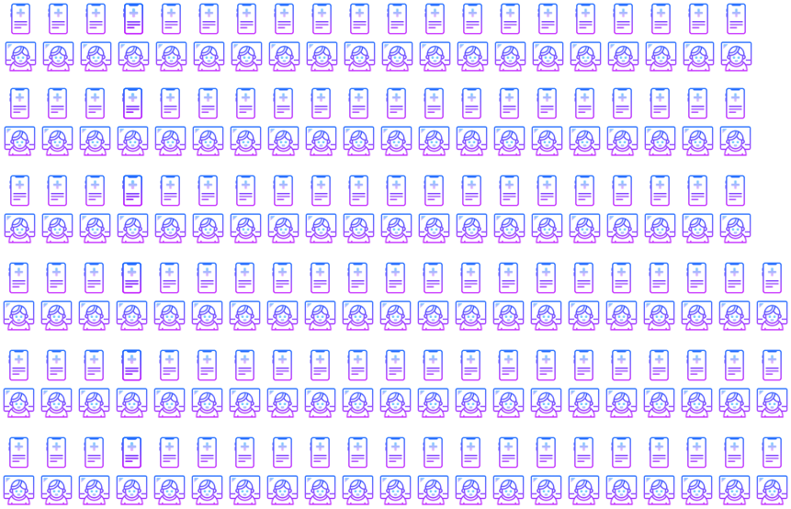
We’ve Seen a 50X Growth in Health Data Over the Past 10 Years
And the creation of 350,000 digital health apps

Slide 9
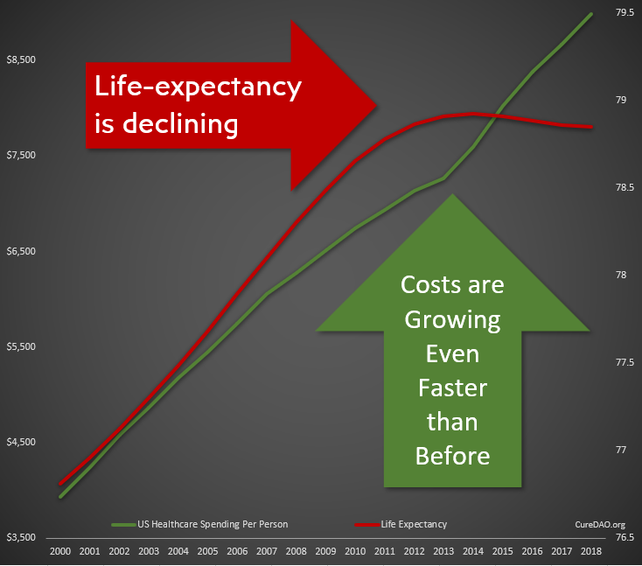
Yet All of This Innovation and Data has Failed to Improve Lifespan or the Cost Burden of Chronic Disease

Slide 10
Problem: Collaboration & Data Sharing
is Punished by the Market
We’re wasting $157 billion paying over 350,000 programmers to write the same code to implement the same basic functionality.
Horizontal Stagnation
Notes:
The free-rider problem and the tragedy of the commons punishes any individual company that open sources it’s code

Slide 11
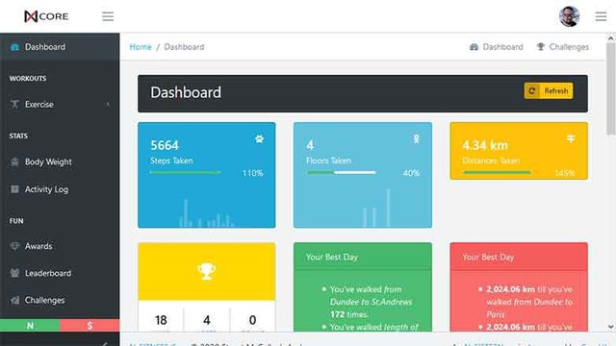
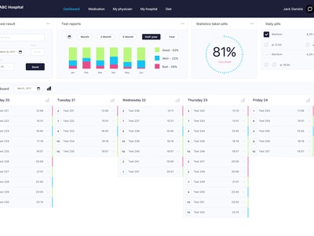
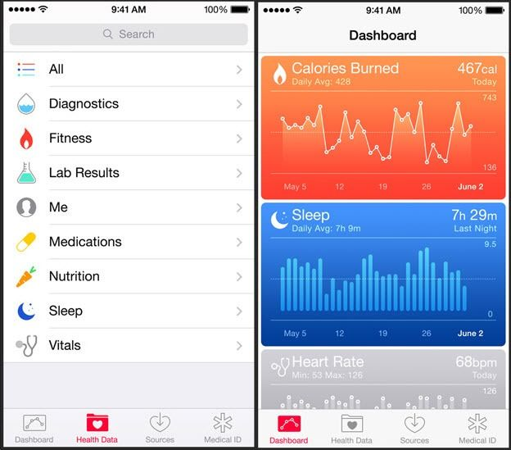
Result: Thousands of Dashboards
Nearly all apps allow you to provide data and show you what you have done rather than what you should do to prevent or treat disease.

Slide 12

Solution: Incentivize Open-Source Collaboration
We can utilize a DAO as a vehicle to reward the creation of public goods.
This allows everyone to stand on everyone’s shoulders, massively accelerating progress.
Vertical Innovation

Slide 13
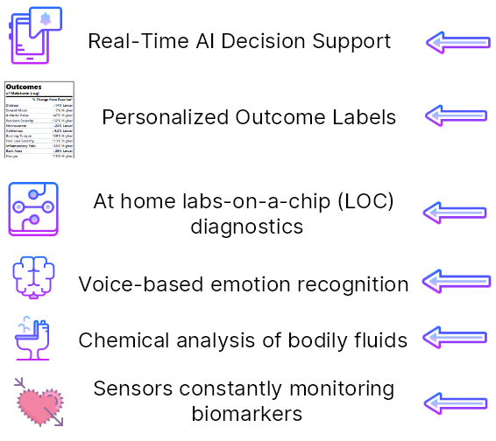
Vertical Innovation
How We Could Be
Spending that
$157 Billion
Notes:
on every medication, food, and nutritional supplement showing the change from baseline for symtoms or disease risk and providing a cost-benefit analysis weighing personal health risk/benfit ratios against the cost of the product.

Slide 14
An Open-Source Ecosystem Model of Success
The WordPress Foundation
Automattic (Wordpress.com)
Maintains the Core WordPress Publishing Platform
GPL Open-Source License
60% Global Market Share
Volunteer contributors make money by selling products and services based on WordPress
For-Profit Company
SaaS Managed WordPress Hosting
$7.5 Billion Valuation
Hosting plans range from freemium to $15,000/month

Slide 15
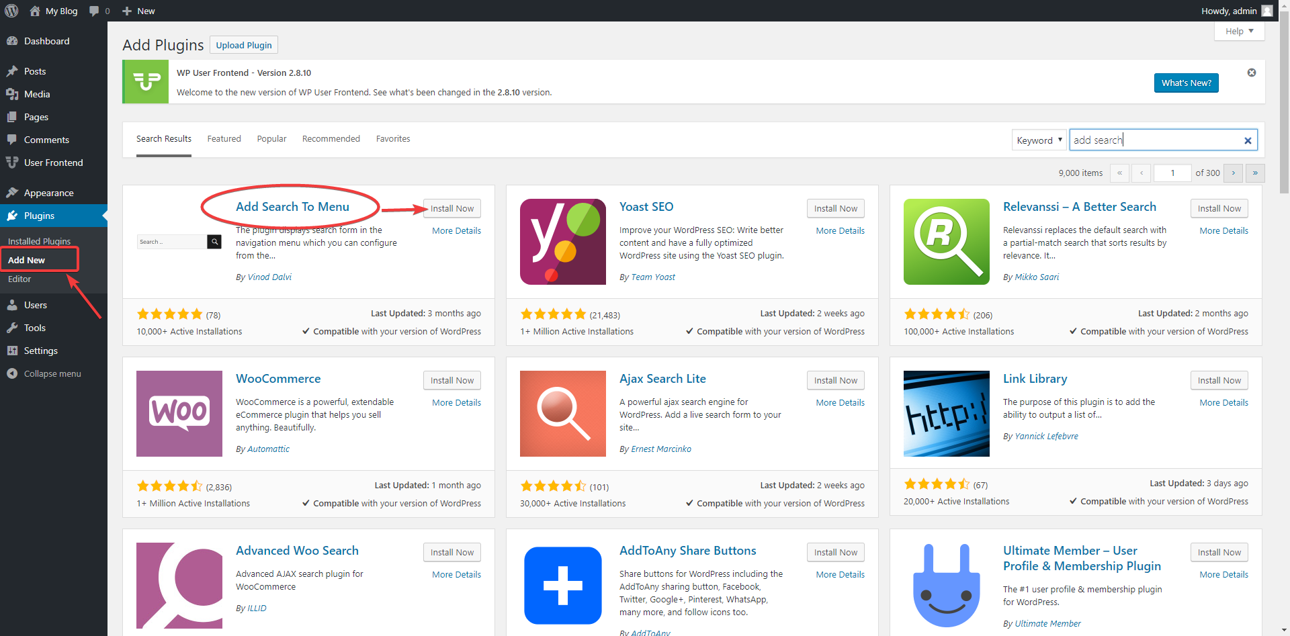
There are more than 59,000 WordPress plugins
The Open-Source Plugin Framework is the Most Critical Factor in its Versatility and Ability to Attract Developers

Slide 16
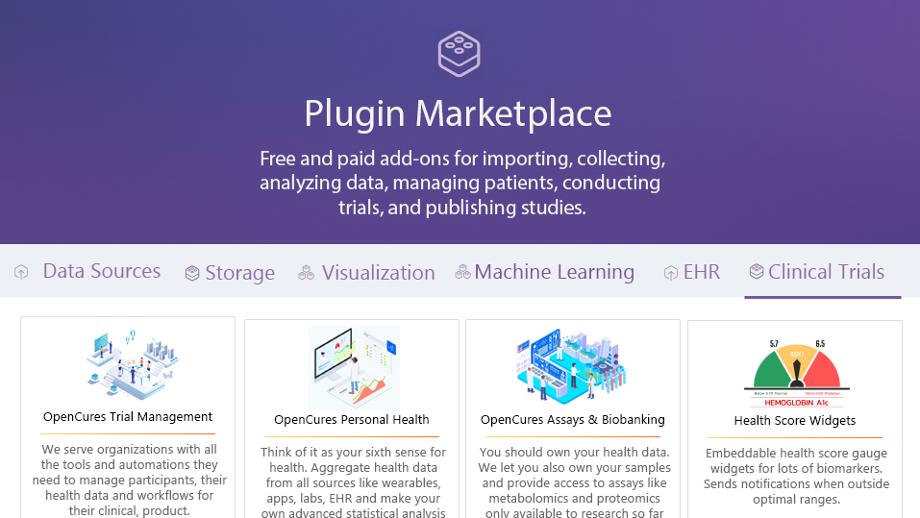
Notes:
For every disease, and many interventions there is an app and they continue to grow. The user interfaces tailor to focus on that disease but they require the same basic core infrastructure.

Slide 17
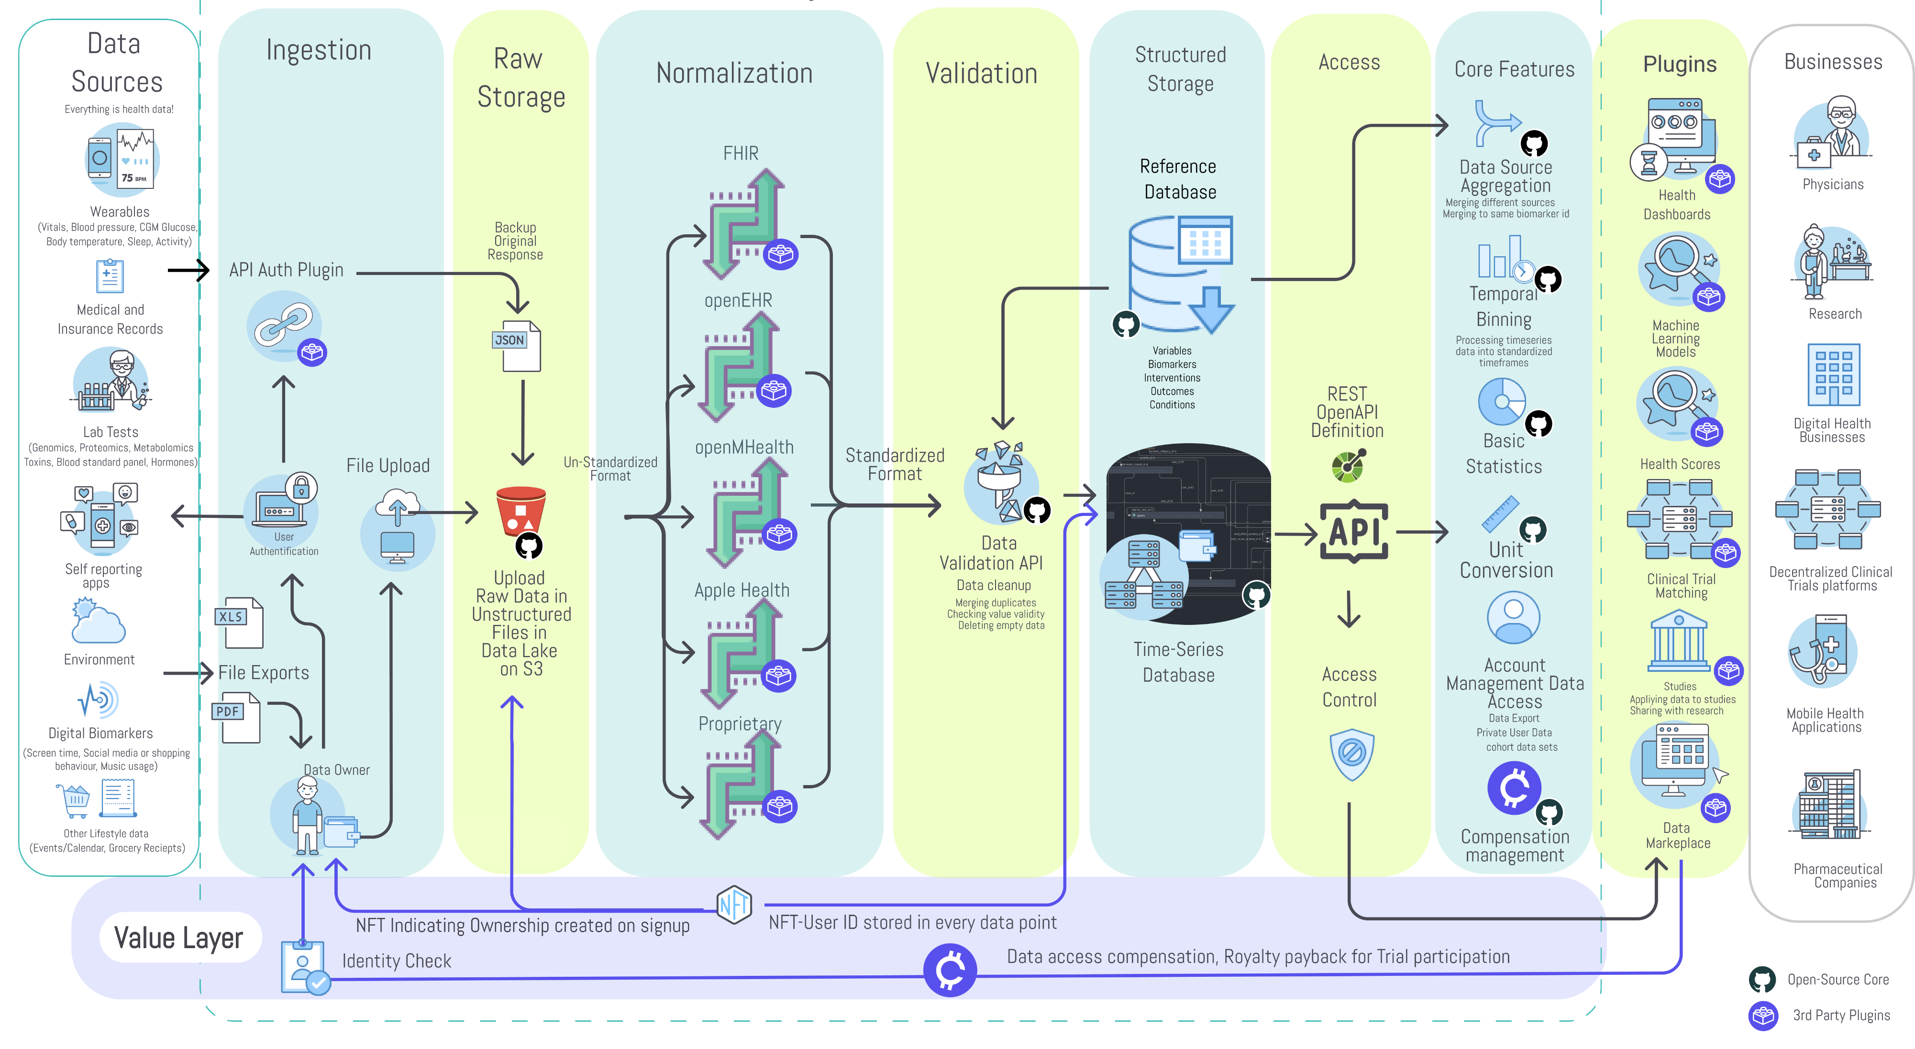

Slide 18
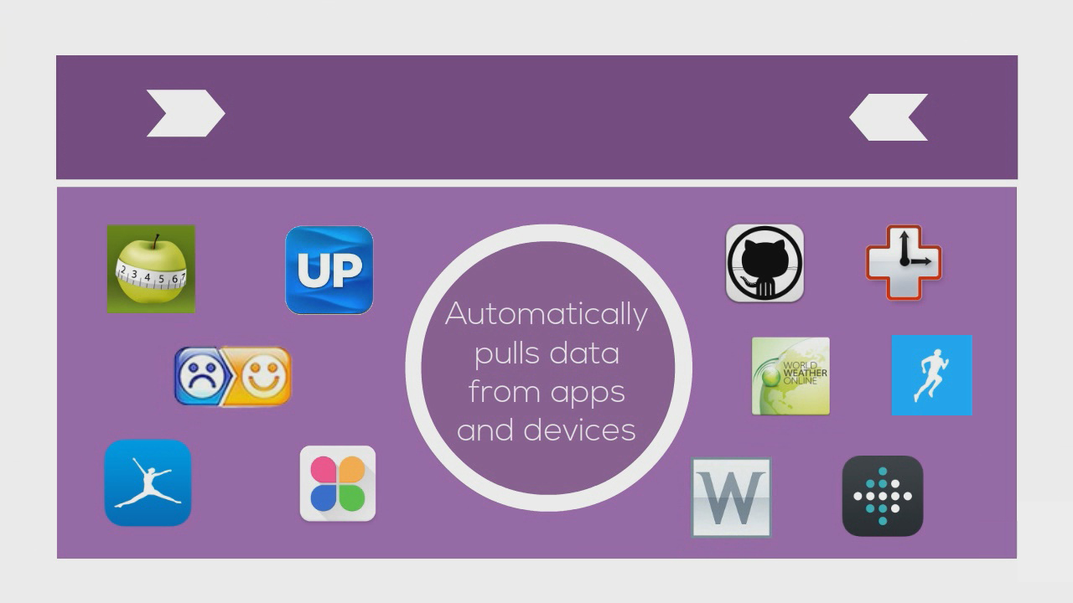

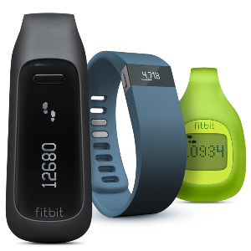


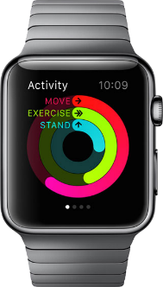
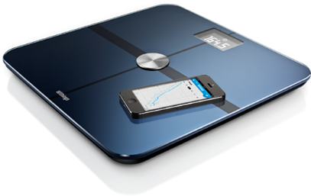
Importer Plugins
Notes:
Move information to left and images on the right.
We also built the QuantiModo Connector Framework, which enabled us to automatically pull passively or actively generated user data from dozens of applications and devices such as Fitbits, Withings scales and blood pressure monitors, and diet data from apps like MyFitnes
The QuantiModo Connector Framework pulls data from dozens of applications and devices such as Fitbits, Withings scales and blood pressure monitors, and diet data from apps like MyFitnessPal.
(Only show most popular ones with names and x more)

Slide 19


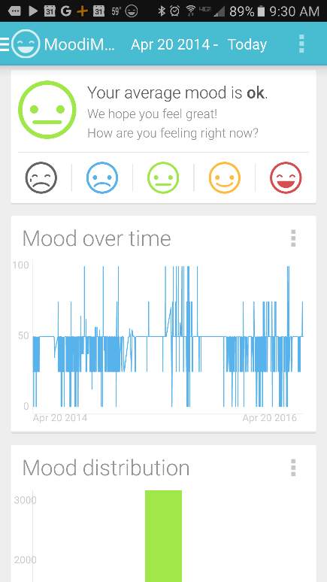
Data Collection Plugins
Back-end-
as-a-Service (BaaS) Functionality for Data Collection Apps
Notes:
First we developed mobile apps and browser extensions to make it incredibly easy to track your symptom severity in a fraction of a second using a unique popup interface.
Move circle
Remove browser
Screenshot of mood tracking screen

Slide 20
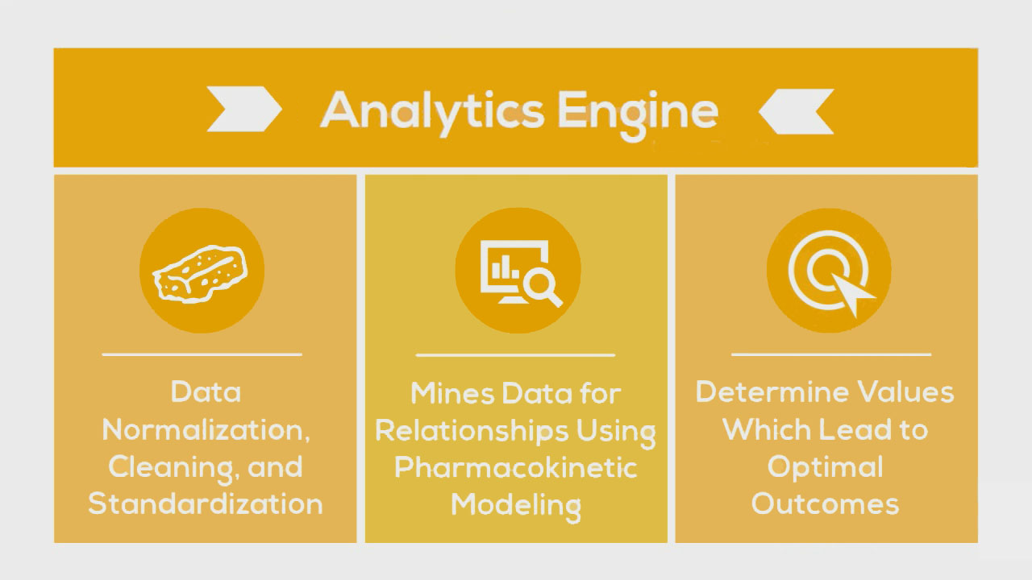
Data Analysis Plugins
Notes:
Change yellow background
Slow down here
Once we’ve accumulated all of this data, the QuantiModo Analytics Engine then clean the data and mines it using pharmacokinetic modeling techniques, which take into account onset delays and durations of action to determine which factors have the strongest influence on a given outcome and what the optimal daily values are.
e.g. Pizza -> might not notice effects until later that day or even gluten sensitivity until a few days later

Slide 21
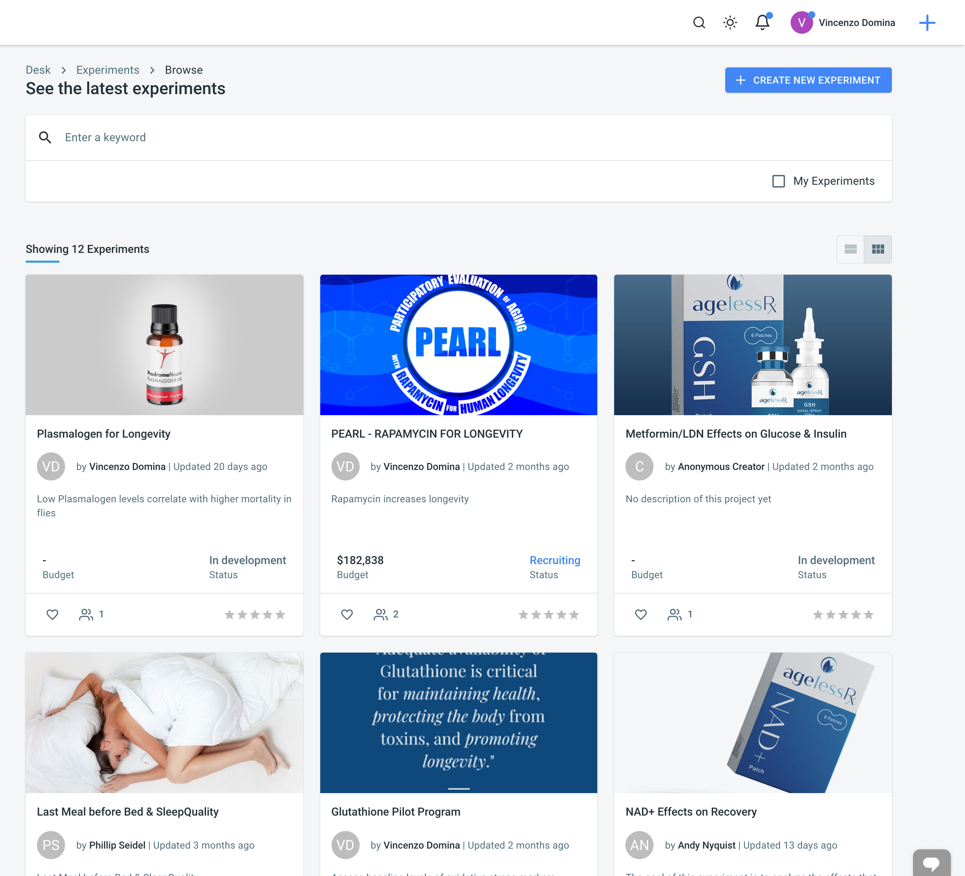
Open Cures Trial Management Plugin
Text hinzufügen

Slide 22
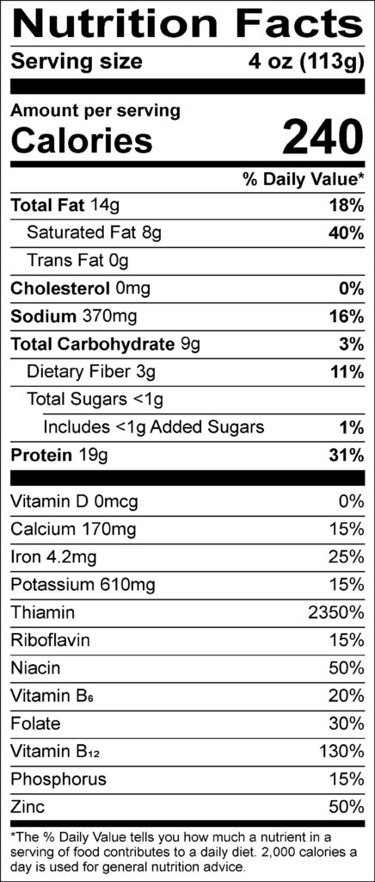
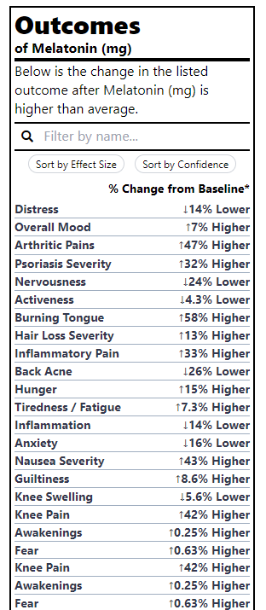
Outcome Labels Plugin
It would be far more valuable to know the health effects of different foods than the amount of riboflavin

Slide 23
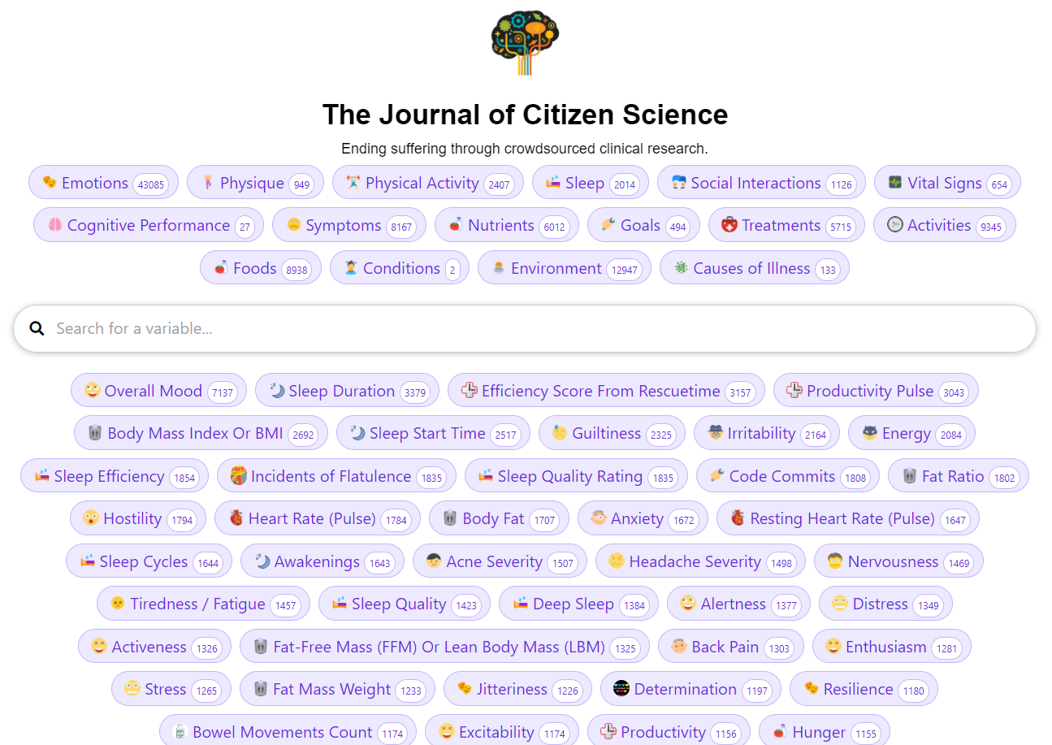
Study Generation Plugins
We’ve created 80,00 studies examining the effects of various factors on symptom severity

Slide 24
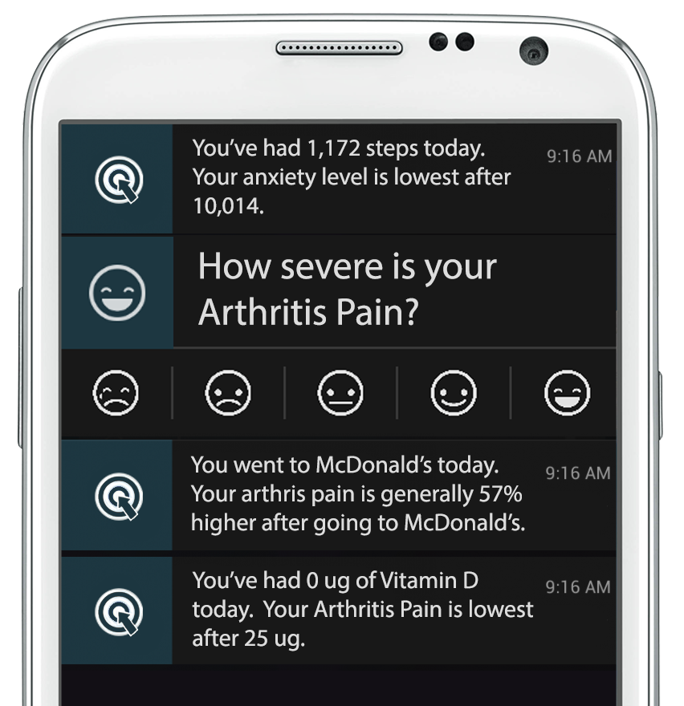
Decision-Support Notification Plugins
We’ve created 80,00 studies examining the effects of various factors on symptom severity

Slide 25
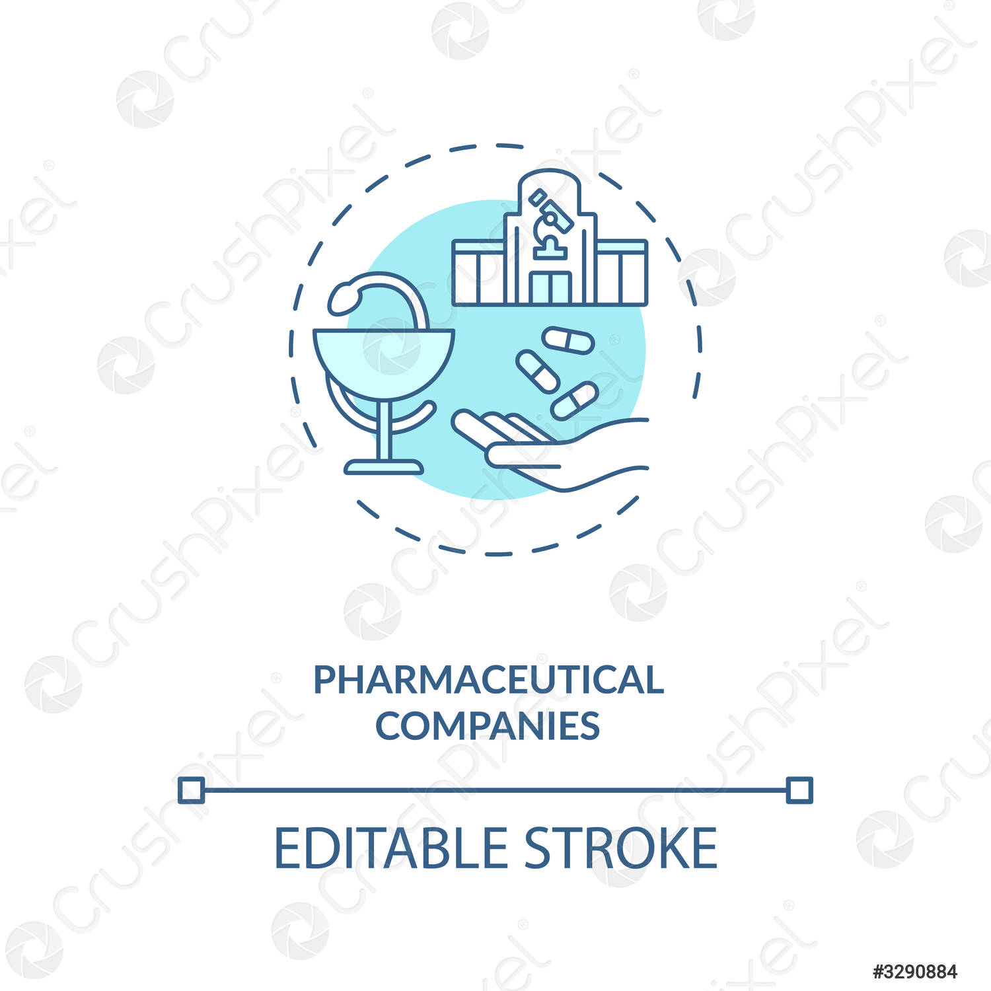















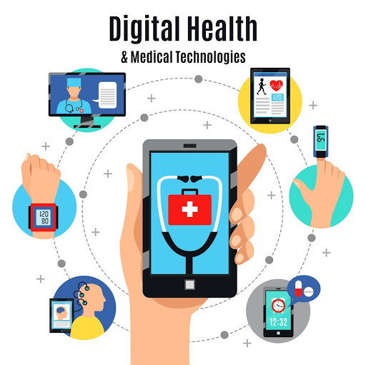



How to Incentivize Collaboration
and Data Sharing
Reduced R&D Costs Through Decentralized Clinical Trial Platform
Grants
Drug Companies
International Regulatory Epidemiological Natural Experiments
Deidentified Data for Drug Discovery
Reduce Exploding Healthcare Costs
De-identified Data Contribution
Personalized Recommendations for Prevention and Treatment of Disease
Reduce Health Agency Development Costs
Individuals
Open-Source Decentralized Clinical Trial Platform
Government
Ongoing NFT Royalties
Reduce Healthcare Expenditure by Facilitating Preventative Discoveries
Supplement Receipt Data
Code, Content and IP Contribution
Grocery Receipt Data
Facilitate De-identified User Data Sharing
Promote Research and Member Engagement More Productive Than Charity Walks
Promotion of Studies
Medication Data
Reduced Development Costs Through Use of White-Label Use of Platform
Software or Data
Ongoing Royalties from NFT
EHR
Developers and Contributors
Insurance Data
Corporate Data Silos
Non-Profits
Digital Health Businesses
Notes:
Should be at 6:00 here
Limit to
Leave numbers out of dictation
Introduce Renato – 1:45
Who Will Pay, 6 segments
Developers
There are 97,000 health apps which can save months of development time and tens of thousands of dollars by using our platform instead of reinventing the wheel.
Researchers
It currently costs $48k per subject in a phase 3 clinical trial. Instead of spending months gathering data, we create a shareable url that researchers can share with participants to authorize access to pre-existing data in quantities never seen before.
Patients
Using our client apps and browser extensions, patients can easily track their symptoms, import data from other sources, and discover hidden dietary, behavioral, and environmental factors that could be exacerbating or improving their symptoms.
Health Insurers
Furthermore, this new digital health solution would help to drive down cost for insurance providers. Health plan providers need a more personalized approach to help their members and have found a way to do so with provider-and patient-reported digital health data. By incorporating this data into a centralized repository, payers can analyze and use this information to create and improve their various member services. For example, in addition to supporting patient-specific care-management models, integrated data could enable the creation of wellness programs, preventive or disease-management care initiatives or even health-coaching programs. This personalized data can go beyond incentivizing and motivating healthy lifestyles; it can also help payers increase member engagement, a critical objective for many health plan providers.
Pharmaceutical Companies
106,000 people die annually in the U.S. from properly prescribed drugs. The number of people having in-hospital, adverse reactions to prescribed drugs to be 2.2 million per year. The total number of deaths caused by conventional medicine is 783,936 per year. Pharmaceutical companies spend over $2 billion a year on over 314,000 events attended by doctors.
Initial sponsor applications will be focused on tracking adverse reactions to the medications known to produce the most adverse reactions. MEDTLC, QuantiModo’s treatment and symptom tracking application would reduce the number of deaths and costs of intervention by alerting patients and their practitioners to conditions before they become irreversible. Additionally, the opportunity to meet and promote these applications to physicians would also serve as a novel new way for pharmaceutical manufacturers to connect with physicians.
Healthcare Providers
A dashboard visualizing all factors in a patient’s health can then help doctors formulate an informed care plan.

Slide 26

Total Addressable Market
613 Million People Track a Health Indicator
x $3 /user/year
= $1.8 Billion TAM
Notes:
We have 6 different segments with 6 different pricing models…
The digital health space has been growing with a massive 50% compound annual growth rate. The healthcare analytics market is a $30 billion dollar industry and includes remote patient monitoring, telehealth, and behavior modification technologies.
Given that Validic and the Human API are already charging about $4 or $5 per year per user. So we believe that $3 per year per user is a competitive price point for us.
613 million people are tracking a health indicator.
$3 per individual per year produces a $1.8 billion dollar total addressable market for QuantiModo.

Slide 27
CLOSED-SOURCE ALTERNATIVES
Company | Price per user per year | Data Aggregation | Open-Source | Plugin Marketplace | Research Platform
Other Platforms | $5 | ✓ | ✗ | ✗ | ✗
CureDAO | $3 | ✓ | ✓ | ✓ | ✓
Notes:
Our primary competitors are Validic and the Human API which primarily focus on the aggregation of data from digital health devices. However, they do not provide prebuilt apps, analytics or an end to end solution for researchers.
That market has clearly been validated by recent $12 and $6 million dollar investments in Validic and the Human API this year as well as continued 50% compound annual growthin the the digital health space.

Slide 28

Team Traction
300 Diagnostic Test Customers
10,000 Users in Over 50 Countries
12 Million Data Points Obtained
80,000 Studies Examining the Effects of Factors on Health Outcomes
23 DAO Members
Notes:
We already have 3000 users and 5 million data points with no marketing efforts and have received very positive reviews on the app stores.
90,000 NATURAL LANGUAGE STUDIES ON THE EFFECTS OF VARIOUS FACTORS ON SYMPTOMS OF CHRONIC ILLNESS

Slide 29
Roadmap
Q1/2022 Build the DAO
Create Whitepaper, Website, Media presence, CI
Define collaborators and partners (DAO infrastructure, health data tech)
Setup DAO architecture and infrastructure
Build community, social media content
Fundraising phase (Genesis)
Q3/2022 Integration and Testing
Integrate with other tech architecture (storage providers, data marketplaces, analysis software, etc.. )
Integrate with operating health data standards and Electronic Health Record
Build showcase plugins
Release V2 of the Software Framework
Promote broader usage
Q2/2022 Minimal Viable Product (MVP)
Collaborators vote for core features
Build MVP alongside use in showcase trial
Closed Testing with collaborators
Release V1 of the Software Framework
Open Testing with partners
Q3/2023 Minimize time to develop new interventions
Manage personal health to prevent disease
Share health data to research
Get to know new insights
Take newly developed interventions
Educate loved ones about longer health-span

Slide 30

THE END

Slide 32
Appendix
Notes:
So there are already hundreds of thousands of apps and dozens of decentralized research and digital health platforms. So why do we need yet another one?

Slide 33
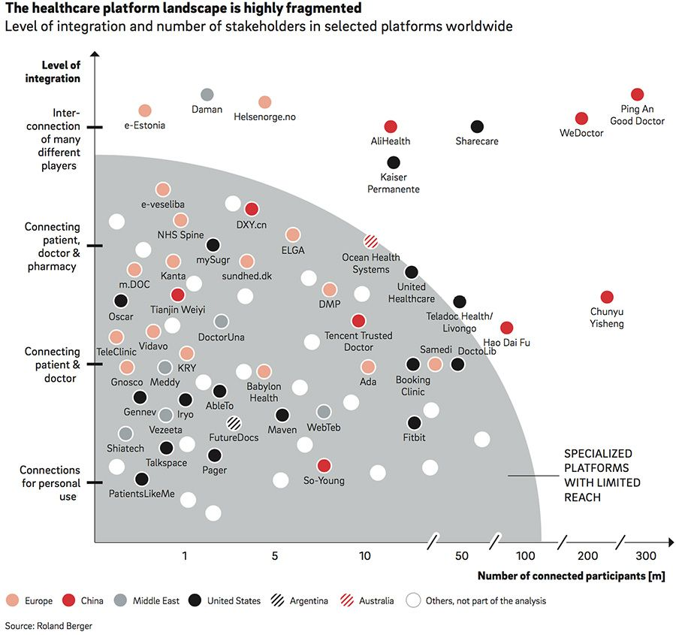
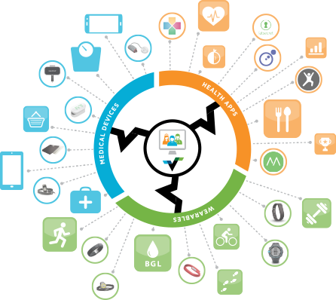

Slide 34
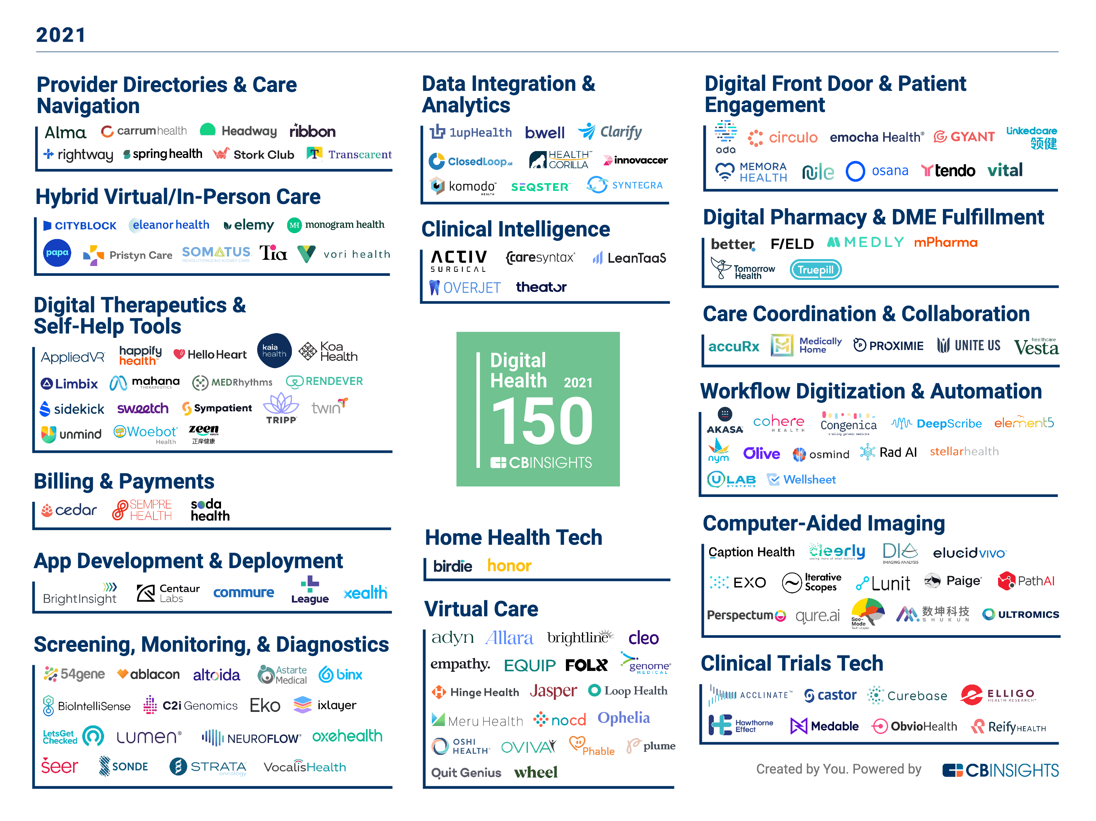

Slide 35
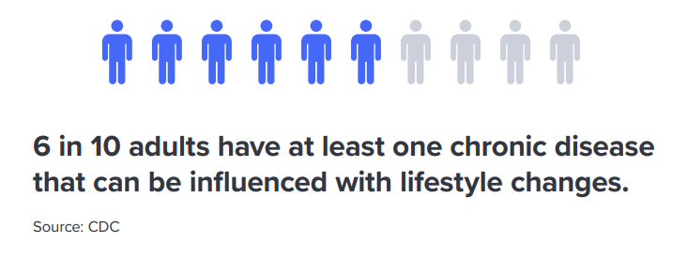

Slide 36
SYMPTOM SEVERITY IS INFLUENCED BY MANY FACTORS
Diet
Social
Symptom Severity
Sleep
Exercise
Environment
Treatments
Notes:
...is that they can be exacerbated or improved by hundreds of factors in daily life like
How much sleep did I get?
What medications did I take?
How much sugar did I consume?
How much gluten did I consume?
gluten intake,
Sugar,
diet,
sleep,
exercise,
social interaction,
and even the weather!
Unfortunately, the human mind evolved to survive in a world without data millions of years ago is only capable of holding 7 numbers in working memory at a time.
Exclude recommended daily allowance
Brains don’t have the bandwidth or statistical processing power required to analyze the massive amount of longitudinal data, time delays, and durations of action that has to be taken into account if we are to determine the likely influence of each of these factors on the individual’s symptoms.
So I built QuantiModo to aggregate and analyze the oceans new active and passively generated human data to determine which of these hundreds of factors have the strongest relationships the symptom or outcome of interest.

Slide 37
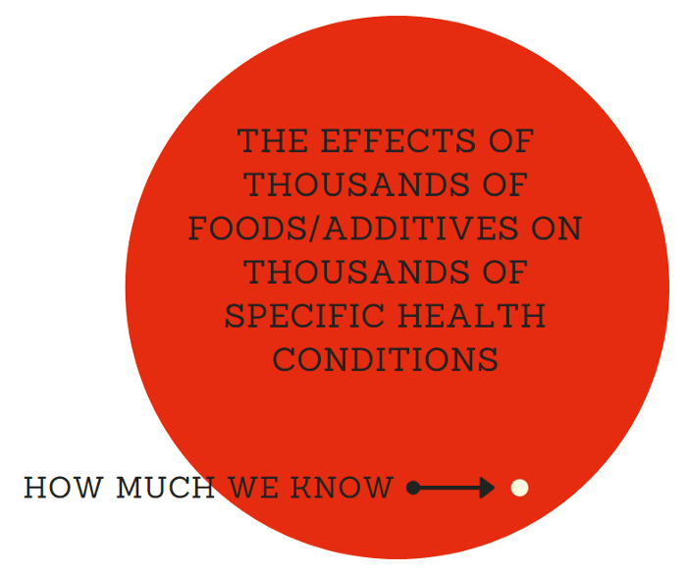

Slide 38
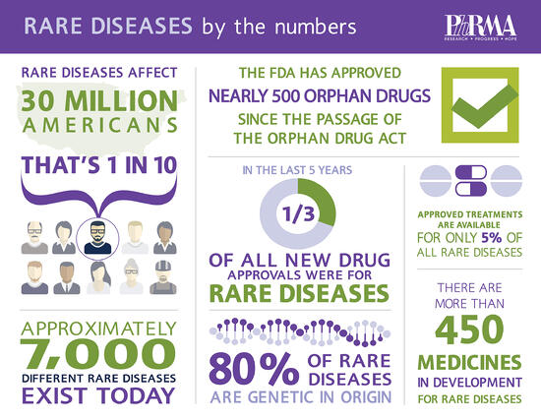

Slide 39
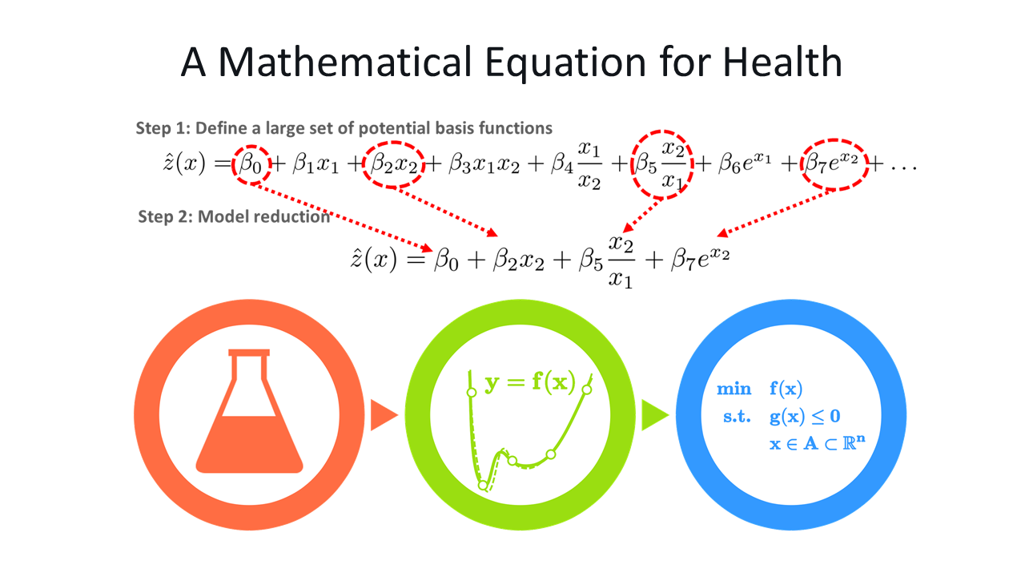

Slide 40
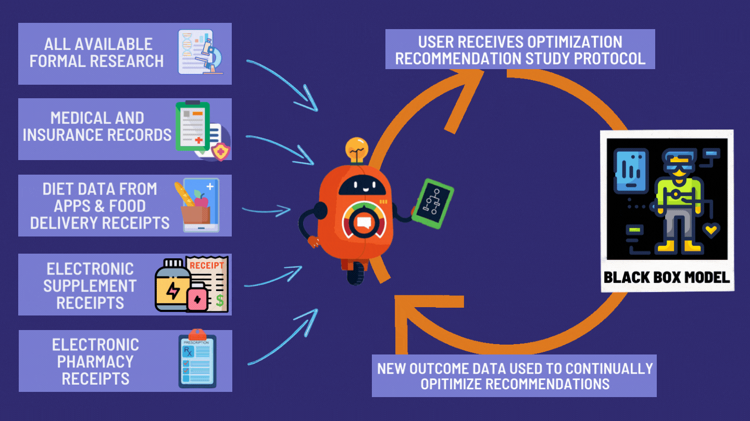

Slide 41





CASE STUDY
Anxiety
Psoriasis
Back Pain
Notes:
To better illustrate what an empirical approach to chronic illness looks like, I’d like to briefly tell you about my experience.
I’ve ben using data to solve problems for about 15 years. Initially, I got my degrees in electrical engineering and physics. Then I spent 10 years using various analytical tools and data analysis to solve thousands of industrial problems as the Director of Chemical Testing at St. Louis Testing Laboratories.
At the lab, we would do a lot of root cause failure analysis for different industries. This generally consisted of gathering data, analyzing it, and using as a basis for research to identify root causes and effective solutions.
During my time there, I developed a number of health conditions like back and joint pain, psoriasis and anxiety. My doctor sent me to several specialists who prescribed an array of medications. These were moderately successful at masking the symptoms but they were very expensive and carried a number of side effects with them. So I decided to apply the same techniques we used in the root cause failure analyses at my lab to figure out what the hell was wrong with me. REFERENCE
While I was there, I developed a number of health symptoms including psoriasis, anxiety, and back and joint pain. My doctor sent me to several specialists. The specialists prescribed an array of medications. These were moderately successful at masking the symptoms but they were very expensive and carried a number of side effects with them. In fact, my Humira prescription cost $25,000 a year.

Slide 42
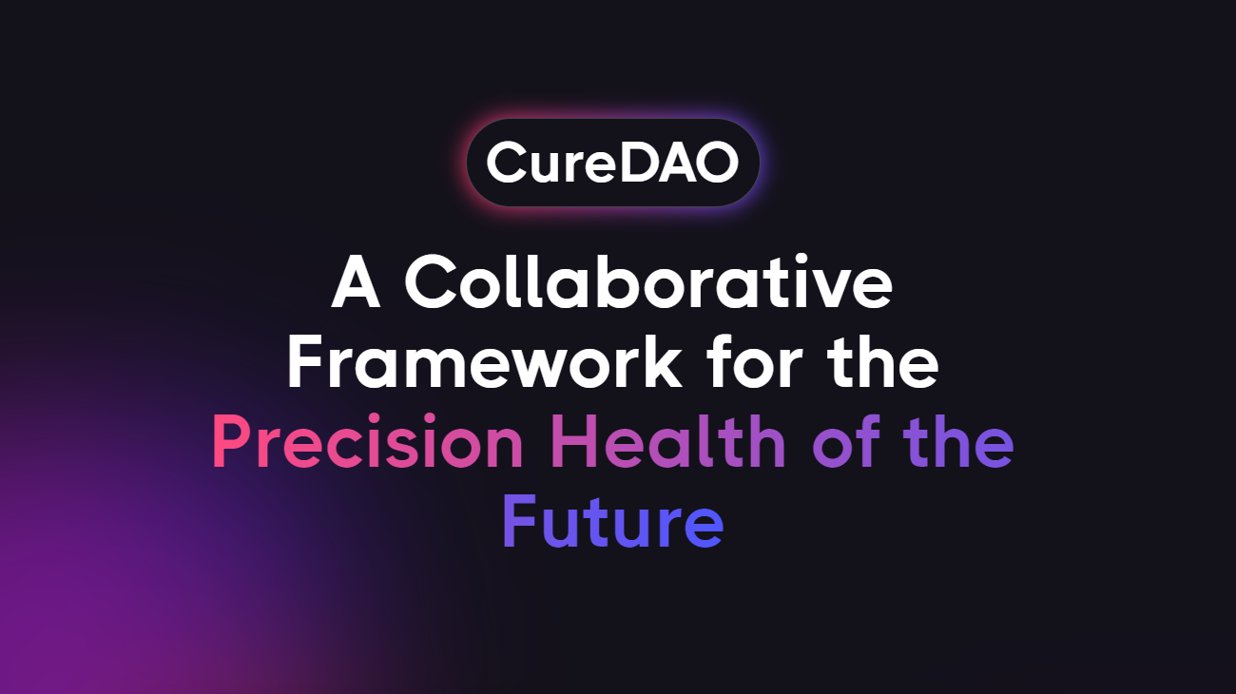
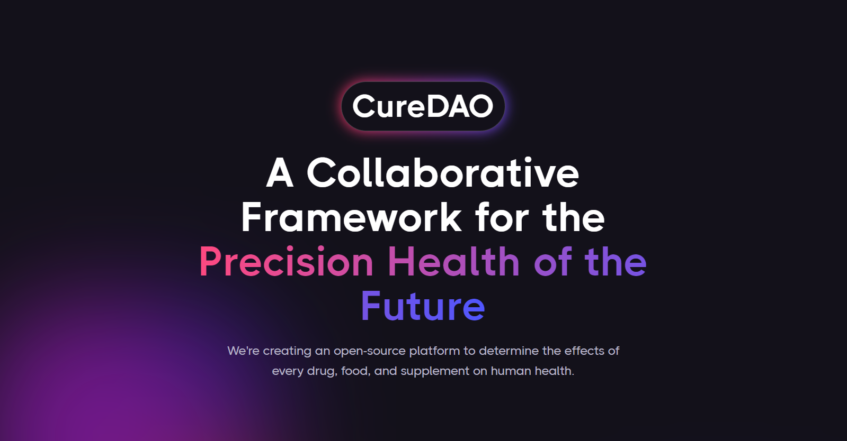
Notes:
We're creating an open-source platform to determine the effects of every drug, food, and supplement on human health.

Slide 43
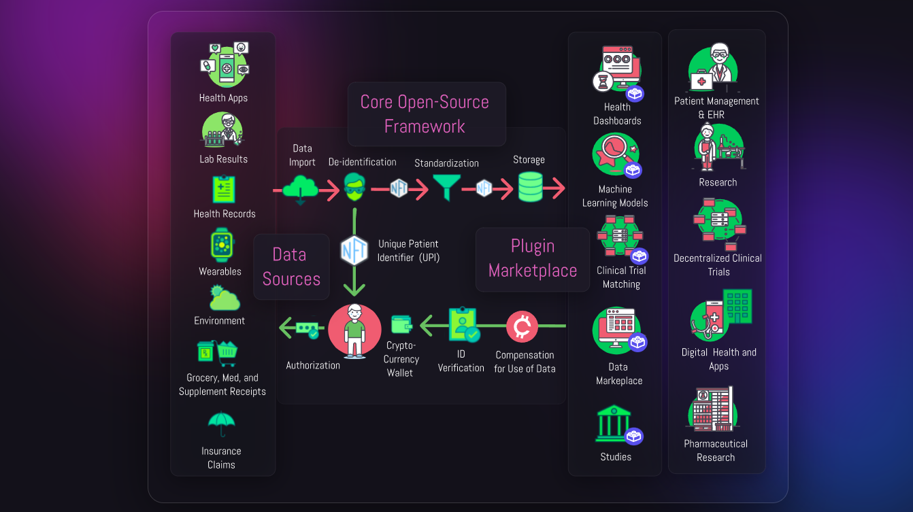

Slide 44
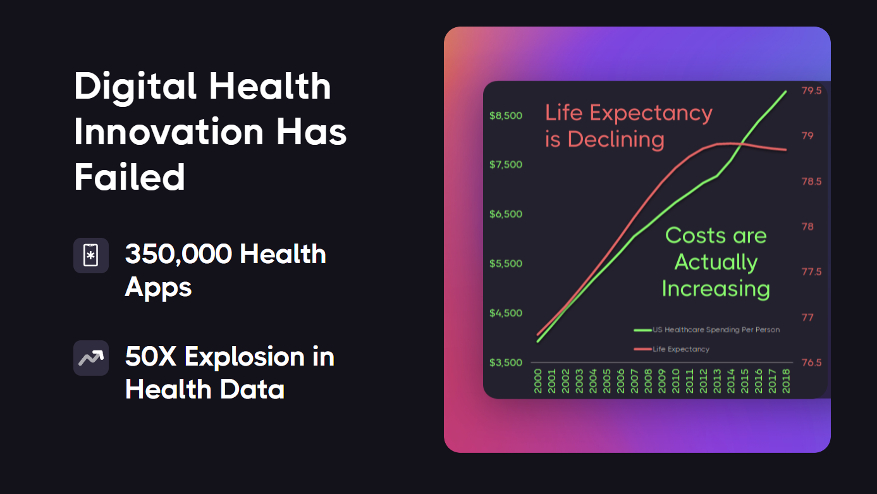
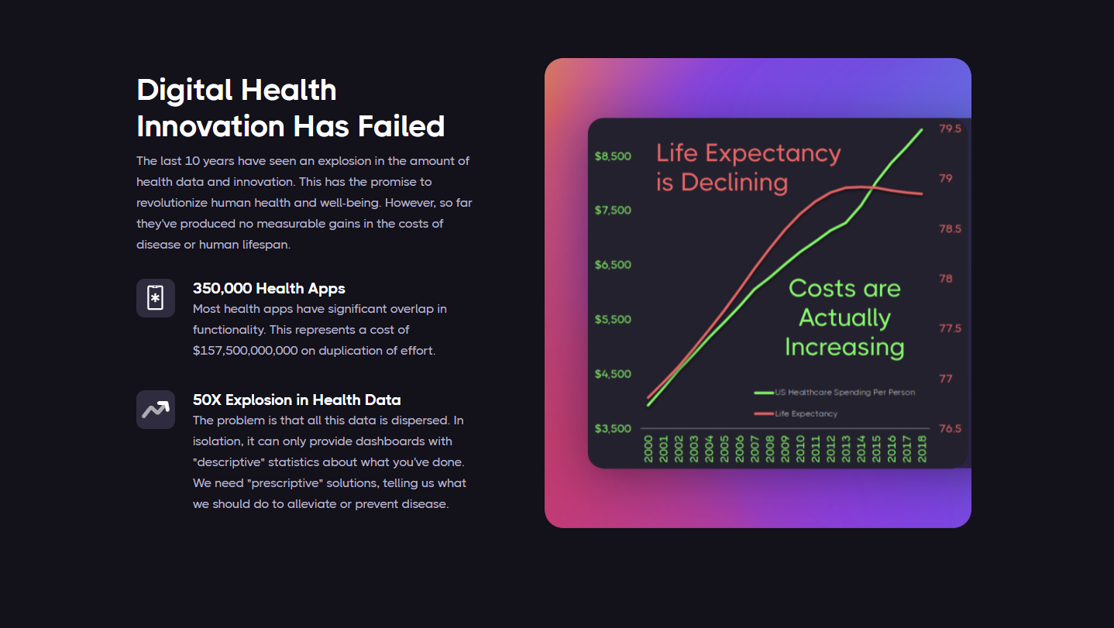
Notes:
The last 10 years have seen an explosion in the amount of health data and innovation. This has the promise to revolutionize human health and well-being. However, so far they've produced no measurable gains in the costs of disease or human lifespan.

Slide 45
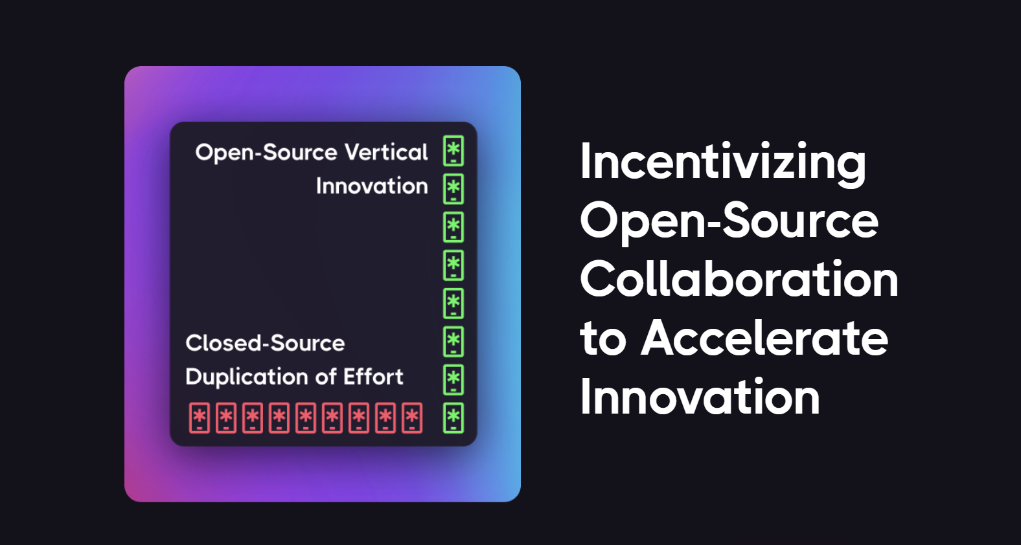
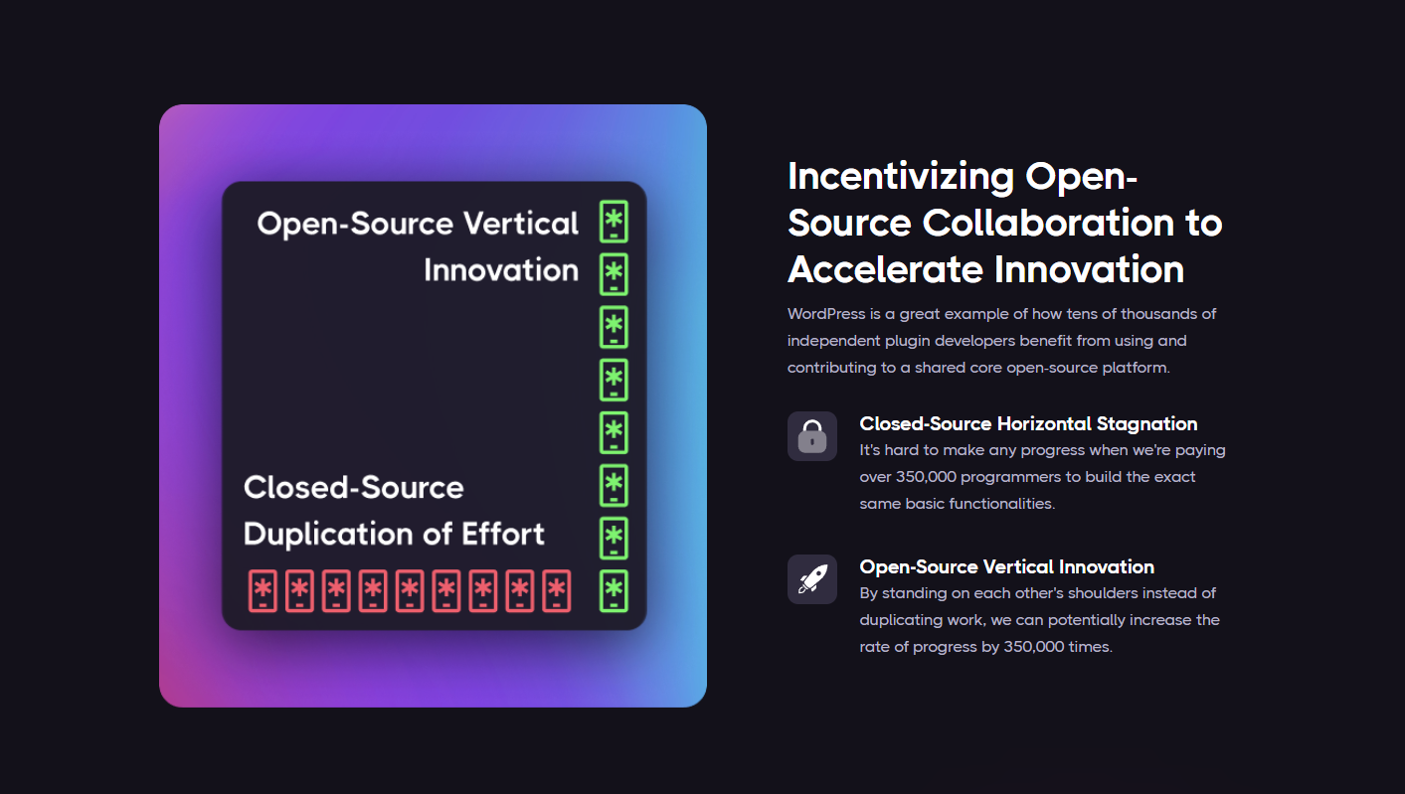
Notes:
It's hard to make any progress when we're paying over 350,000 programmers to build the exact same basic functionalities.
By standing on each other's shoulders instead of duplicating work, we can potentially increase the rate of progress by 350,000 times.
WordPress is a great example of how tens of thousands of independent plugin developers benefit from using and contributing to a shared core open-source platform.

Slide 46
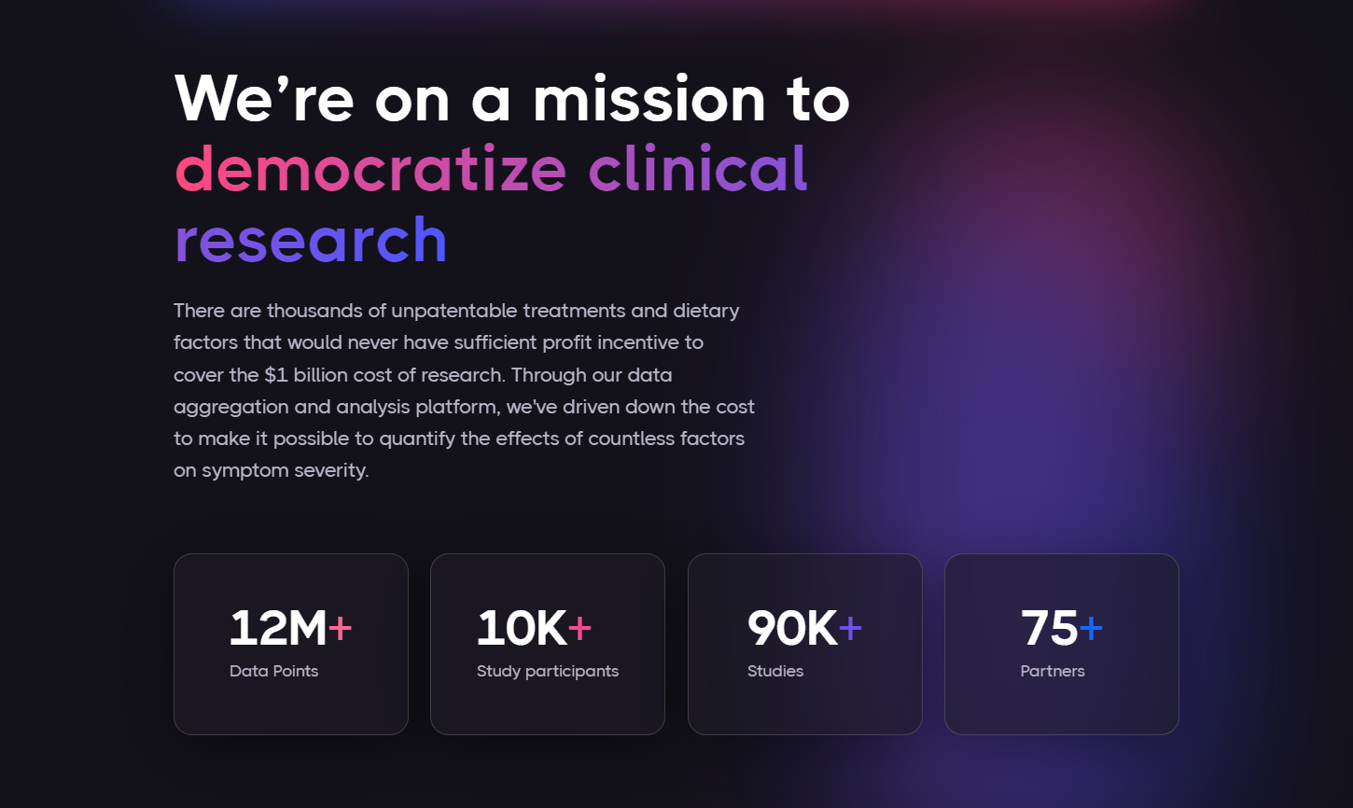
Notes:
There are thousands of unpatentable treatments and dietary factors.
99% of these would never have sufficient profit incentive to cover the $1 billion cost of research.
Through our data aggregation and analysis platform, we've driven down the cost to make it possible to quantify the effects of countless factors on symptom severity.

Slide 47
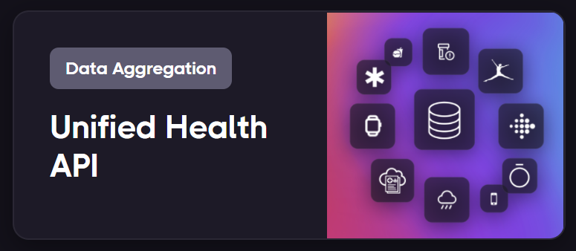
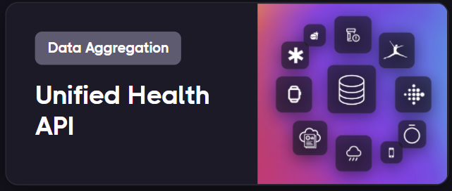
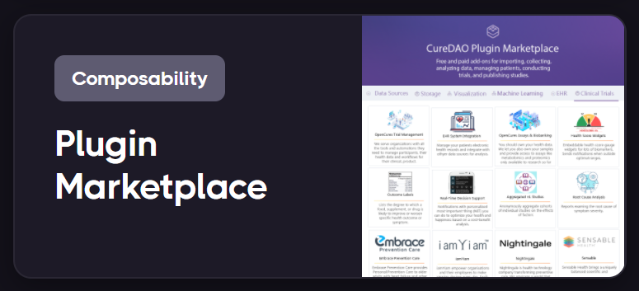
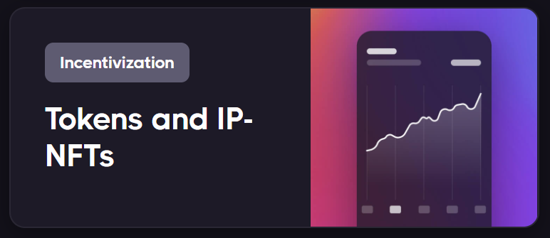
How it works
Notes:
Unified Health API
The core open-source platform standardizes data from a wide array of sources and formats.
Anyone can create and monetize plugins that provide data analysis, management, and visualizations.
As a permissionless decentralized autonomous organization, CureDAO is open to anyone. You can earn tokens by completing quests and experiments to further the mission. We're looking for designers, developers, data scientists, and anyone interested in reducing suffering.
Unified Health API
The core open-source platform standardizes data from a wide array of sources and formats.
Plugin Marketplace
Anyone can create and monetize plugins that provide data analysis, management, and visualizations.
Tokens and IP-NFTs
Contributors of data, work, or intellectual property get a share of all DAO revenue in the form of ongoing royalty payments.

Slide 48
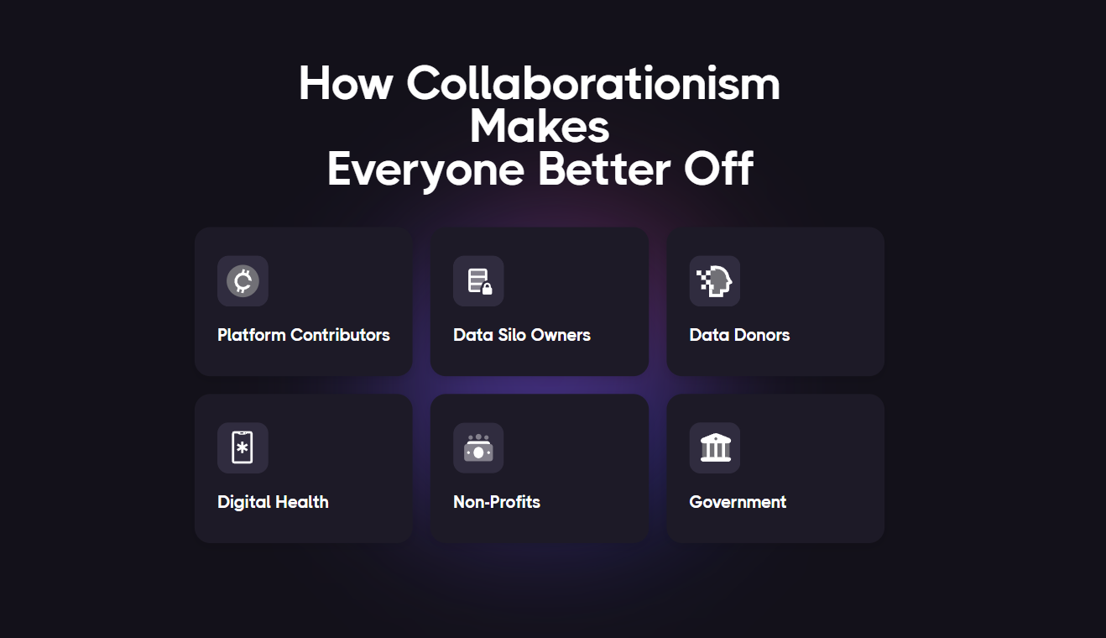

Slide 49


